Slide 1
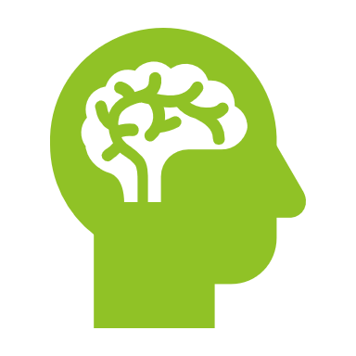

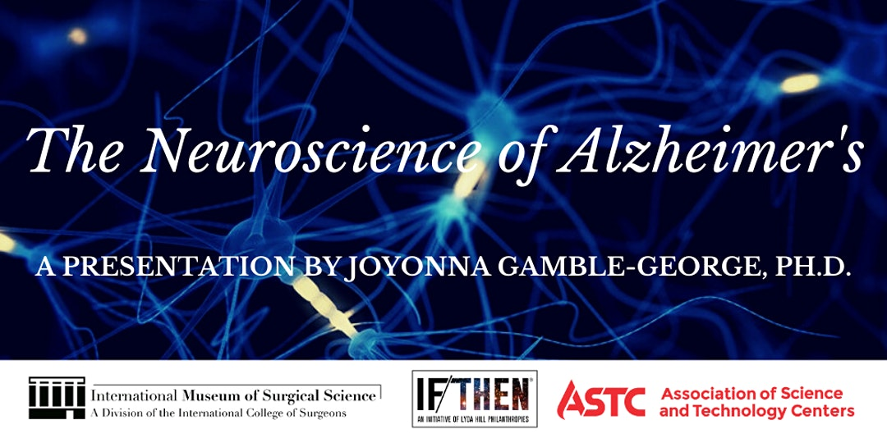

The Neuroscience of Alzheimer’s
Joyonna Gamble-George, Ph.D.

Slide 2
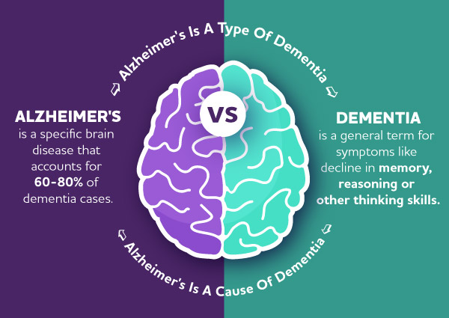
What is Alzheimer’s Disease (AD)?
Source: Alzheimer’s Association (https://www.alz.org/)
Notes:
Alzheimer’s disease is a degenerative brain disease and the most common form of dementia among older adults. Dementia is not a specific disease. It’s a term that describes a group of symptoms. Dementia is the loss of cognitive functioning—thinking, remembering, and reasoning—and behavioral abilities to such an extent that it interferes with a person’s daily life and activities.
The characteristic symptoms of dementia are difficulties with memory, language, problem-solving and other thinking skills that affect a person's ability to perform everyday activities.
Degeneration refers to the process by which tissue deteriorates progressively and often irreversibly, and loses its functional ability due to traumatic injury, aging and wear and tear.

Slide 3
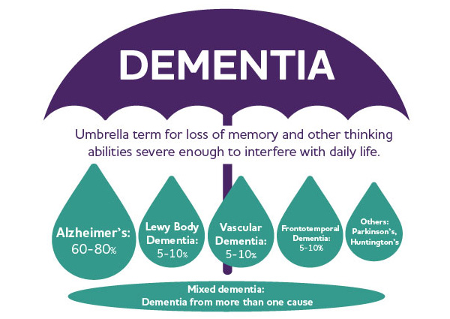
What is Alzheimer’s Disease (AD)?
Source: Alzheimer’s Association (https://www.alz.org/)
Notes:
Other dementias include lewy body dementia, vascular dementia, frontotemporal dementia, Parkinson’s dementia, and Huntington’s. It is common for people to have mixed dementia—a combination of two or more types of dementia.
Lewy body dementia (LBD) is a disease associated with abnormal deposits of a protein called alpha-synuclein in the brain. These deposits, called Lewy bodies, affect chemicals in the brain whose changes, in turn, can lead to problems with thinking, movement, behavior, and mood.
Vascular dementia refers to progressive loss of memory and other cognitive functions caused by vascular injury or disease within the brain. It can arise as a result of risk factors that similarly increase the risk for cerebrovascular disease (stroke), including atrial fibrillation (a problem with the rhythm of the heartbeat), high blood pressure, diabetes, and high cholesterol.
Damage to the brain’s frontal and temporal lobes causes forms of dementia called frontotemporal disorders. As neurons die in the frontal and temporal regions, these lobes atrophy, or shrink. Gradually, this damage causes difficulties in thinking and behaviors normally controlled by these parts of the brain. Many possible symptoms can result, including unusual behaviors, emotional problems, trouble communicating, difficulty with work, or difficulty with walking.
Parkinson disease is a movement disorder. It can cause the muscles to tighten and become rigid. This makes it hard to walk and do other daily activities. People with Parkinson’s disease also have tremors and may develop cognitive problems, including memory loss and dementia. Memory and thinking problems in Parkinson’s are caused by changes in the structure and chemistry of the brain. Parkinson disease arises from decreased dopamine production in the brain. The absence of dopamine makes it hard for the brain to coordinate muscle movements. Low dopamine also contributes to mood and cognitive problems later in the course of the disease. At the level of the brain, Parkinson’s dementia is thought to be related to Lewy bodies (sticky clumps of protein found in nerve cells of people with Parkinson’s). Parkinson's disease dementia is a decline in thinking and reasoning that develops in many people living with Parkinson’s at least a year after diagnosis.
Huntington's disease is an inherited genetic condition that causes dementia. It causes a slow, progressive decline in a person's movement, memory, thinking and emotional state.

Slide 4
Facts & Stats About Alzheimer’s
5+ million Americans of all ages have Alzheimer’s
~5.8 million Americans age 65 and older are living with Alzheimer's dementia in 2020
Almost two-thirds of Americans with Alzheimer's are women
Older African-Americans are twice as likely to have Alzheimer's or other dementias as older whites
Hispanics are about one and one-half times as likely to have Alzheimer's or other dementias as older whites
Notes:
Millions of Americans have Alzheimer’s. Alzheimer's is not just a disease of old age. Younger-onset (also known as early onset) Alzheimer's affects people younger than age 65. Up to 5 percent of the more than 5 million Americans with Alzheimer’s have younger onset. As the size of the U.S. population age 65 and older continues to increase, the number of Americans with Alzheimer’s will grow. Some studies find women, blacks/African Americans, and Hispanics/Latinos to be at increased risk for Alzheimer’s.
The prevailing reason that has been stated for the higher prevalence of Alzheimer’s in women is that women live longer than men on average, and older age is the greatest risk factor for Alzheimer’s. Some research suggests that if women’s risk for Alzheimer’s is higher, it is possible that lower educational attainment in women than in men born in the first half of the 20th century could account for some of the elevated risk, as limited formal education is a risk factor for dementia. People with more years of formal education are at lower risk for Alzheimer’s and other dementias than those with fewer years of formal education. Some researchers believe that having more years of education builds “cognitive reserve.” Cognitive reserve refers to the brain’s ability to make flexible and efficient use of cognitive networks (networks of neuron-to-neuron connections) to enable a person to continue to carry out cognitive tasks despite brain changes such as beta-amyloid and tau accumulation. Other research is assessing whether the risk of Alzheimer’s could actually be higher for women at any given age due to genetic differences or different susceptibility to Alzheimer’s pathology.
Despite some evidence that the influence of genetic risk factors on Alzheimer’s and other dementias may differ by race, genetic factors do not appear to account for the large differences in prevalence or incidence among racial groups. Instead, health conditions such as cardiovascular disease and diabetes, which are associated with an increased risk for Alzheimer’s, are believed to account for these differences, as they are more prevalent in black/African American and Hispanic/Latino people. Socioeconomic characteristics, including lower levels and quality of education, higher rates of poverty, and greater exposure to adversity and discrimination, may also increase risk in black/African American and Hispanic/Latino communities (and may in turn contribute to CVD and diabetes, which are associated with an increased risk for AD).
The prevalence of Alzheimer’s dementia refers to the number and proportion of people in a population who have Alzheimer’s dementia at a given point in time.
Incidence refers to the number or rate of new cases per year.

Slide 5
Facts & Stats About Alzheimer’s
Source: Alzheimer’s Association. 2020 Alzheimer’s Disease Facts and Figures. Alzheimers Dement 2020;16(3):391+
Notes:
As shown in the Figure, between 2020 and 2025 every state across the country is expected to experience an increase of at least 6.7% in the number of people with Alzheimer’s. These projected increases in the number of people with Alzheimer’s are due to projected increases in the population age 65 and older in these states.

Slide 6
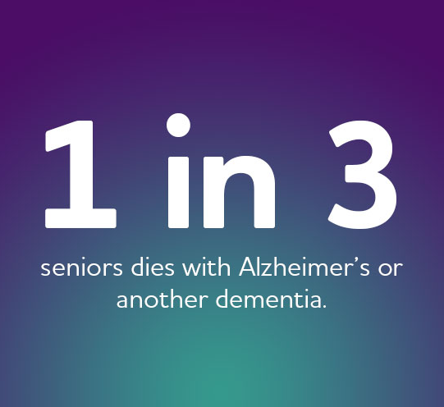
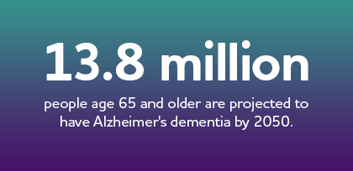

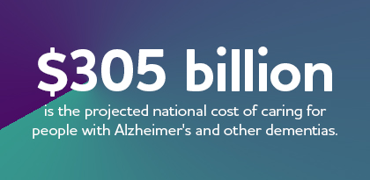
Notes:
Alzheimer’s disease is the sixth-leading cause of death in the United States. Alzheimer’s is also a leading cause of disability and poor health (morbidity). Severe dementia frequently causes complications such as immobility, swallowing disorders and malnutrition that significantly increase the risk of serious acute conditions that can cause death. One such condition is pneumonia (infection of the lungs), which is the most commonly identified immediate cause of death among older adults with Alzheimer’s.
By 2050, the number of people age 65 and older with Alzheimer’s dementia is projected to reach 13.8 million.
Eighty-three percent of the help provided to older adults in the United States comes from family members, friends or other unpaid caregivers. Family members and friends provided nearly $244 billion in unpaid care to people with Alzheimer’s and other dementias in 2019.
Dementia is one of the costliest conditions to society. People with Alzheimer’s have twice as many hospital stays per year as other older people. people with coronary artery disease, diabetes, chronic kidney disease, chronic obstructive pulmonary disease (COPD), stroke or cancer who also have Alzheimer’s or other dementias have higher use and costs of health care services than people with these medical conditions but no coexisting dementia. Older people with Alzheimer’s have more skilled nursing facility stays and home health care visits per year than other older people. In 2020, the total national cost of caring for people with Alzheimer’s and other dementias is projected to reach $305 billion.

Slide 7

Signs and Symptoms of Alzheimer's Disease

Slide 8
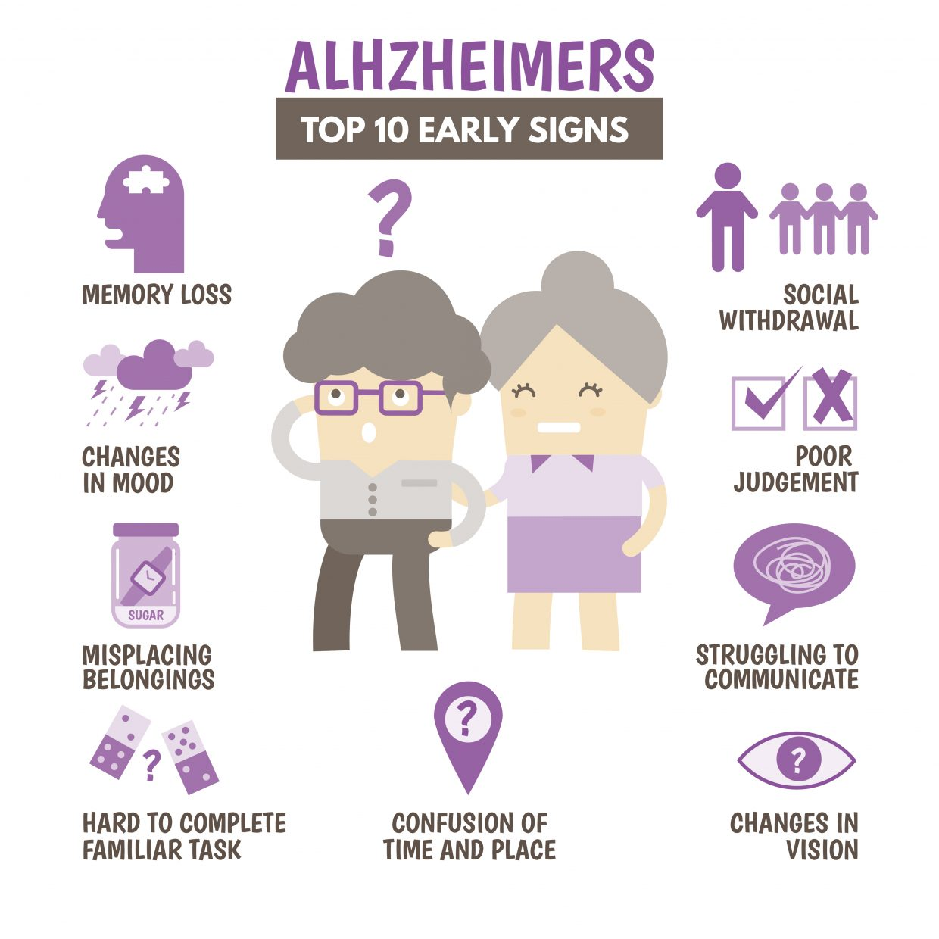
Signs and Symptoms of Alzheimer's Disease
Notes:
There are 10 warning signs and symptoms of AD.
Memory Loss
One of the most common signs of Alzheimer’s disease, especially in the early stage, is forgetting recently learned information. Others include forgetting important dates or events, asking for the same questions over and over, and increasingly needing to rely on memory aids (e.g., reminder notes or electronic devices) or family members for things they used to handle on their own.
Changes in Mood
Individuals living with Alzheimer’s may experience mood and personality changes. They can become confused, suspicious, depressed, fearful or anxious. They may be easily upset at home, with friends or when out of their comfort zone.
Misplacing Belongings
A person living with Alzheimer's disease may put things in unusual places. They may lose things and be unable to go back over their steps to find them again.
Hard to Complete Familiar Task
People with Alzheimer's often find it hard to complete daily tasks. Sometimes they may have trouble driving to a familiar location, organizing a grocery list or remembering the rules of a favorite game.
Confusion of Time and Place
People living with Alzheimer's can lose track of dates, seasons and the passage of time. They may have trouble understanding something if it is not happening immediately. Sometimes they may forget where they are or how they got there.
Social Withdrawal
A person living with Alzheimer’s disease may experience changes in the ability to hold or follow a conversation. As a result, he or she may withdraw from hobbies, social activities or other engagements. They may have trouble keeping up with a favorite team or activity.
Poor Judgment
Individuals may experience changes in judgment or decision-making. For example, they may use poor judgment when dealing with money or pay less attention to grooming or keeping themselves clean.
Struggling to Communicate
People living with Alzheimer's may have trouble following or joining a conversation. They may stop in the middle of a conversation and have no idea how to continue or they may repeat themselves. They may struggle with vocabulary, have trouble naming a familiar object or use the wrong name (e.g., calling a "watch" a "hand-clock").
Changes in Vision
For some people, having vision problems is a sign of Alzheimer's. This may lead to difficulty with balance or trouble reading. They may also have problems judging distance and determining color or contrast, causing issues with driving.
Challenges in Planning or Solving Problems
Some people living with dementia may experience changes in their ability to develop and follow a plan or work with numbers. They may have trouble following a familiar recipe or keeping track of monthly bills. They may have difficulty concentrating and take much longer to do things than they did before.

Slide 9
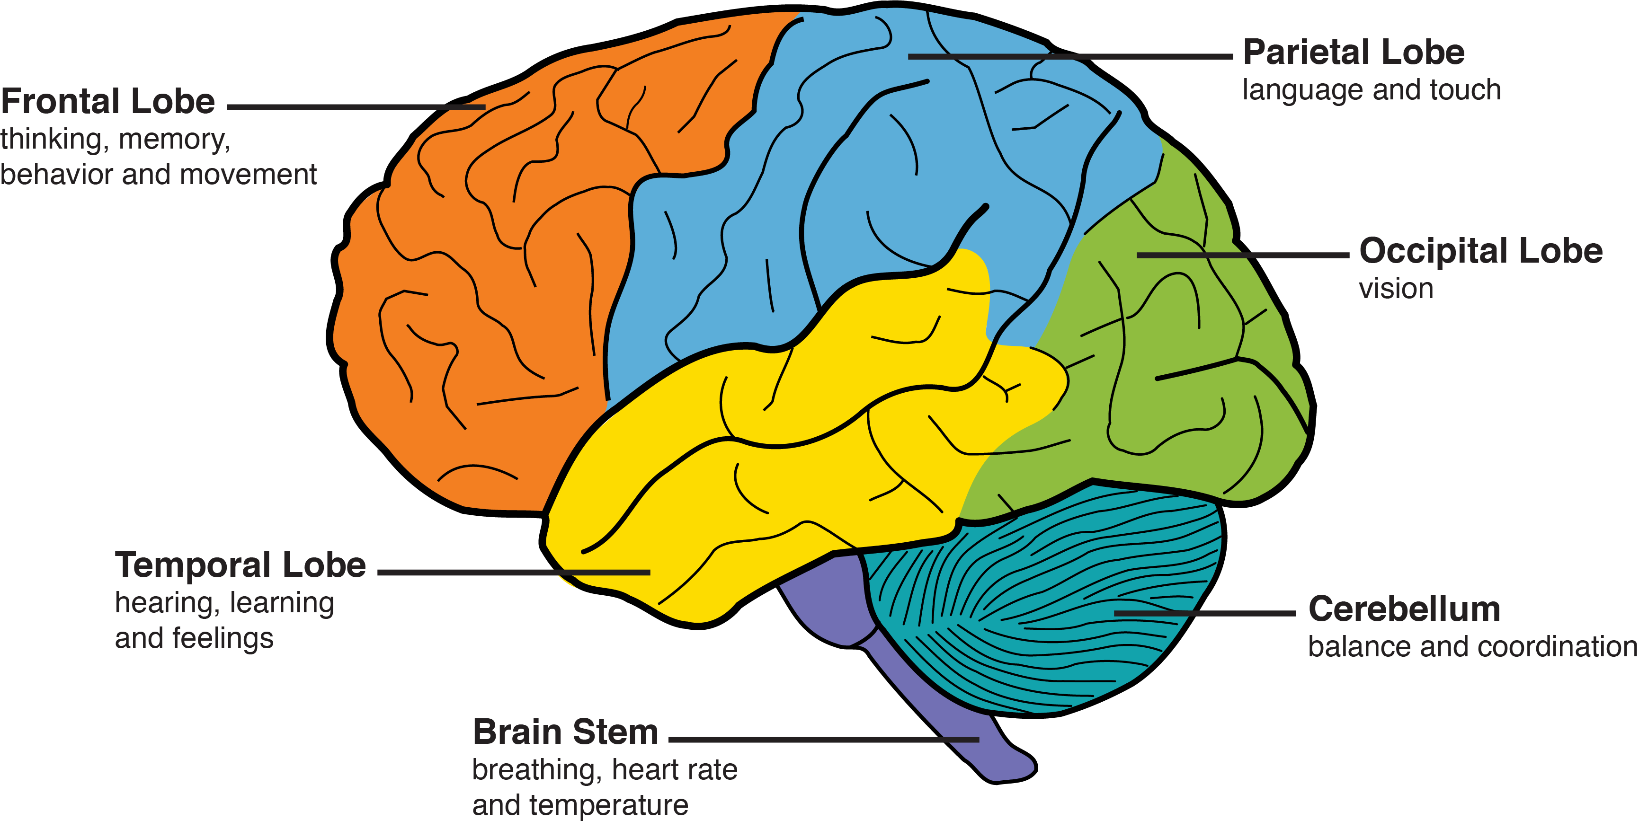
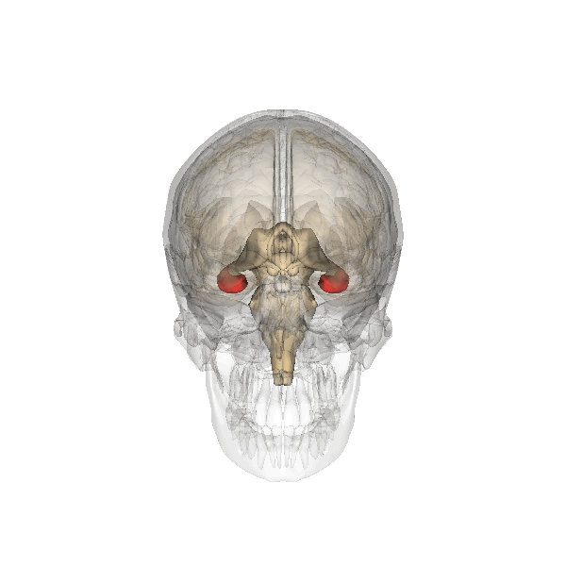
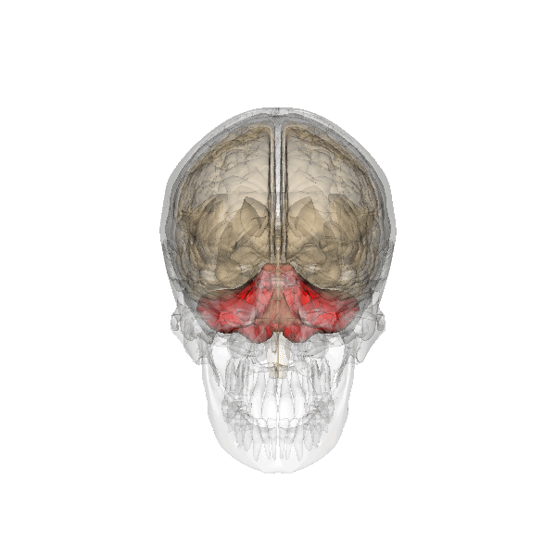
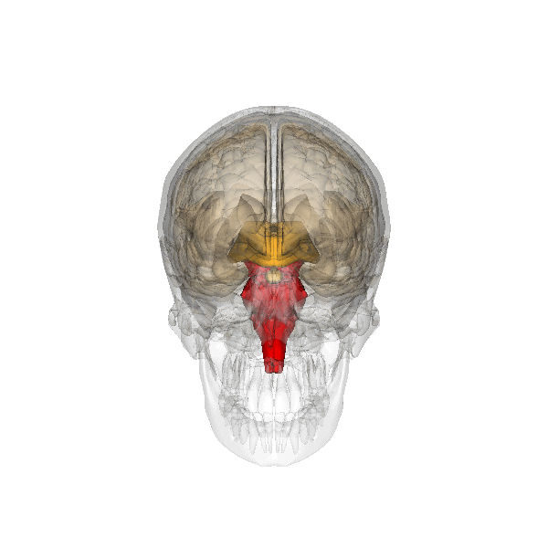
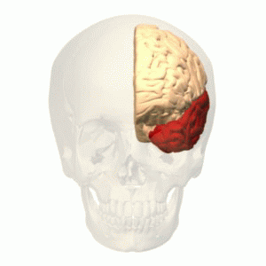
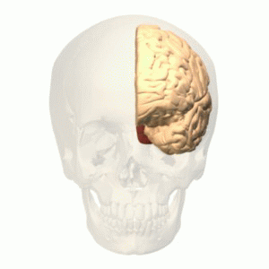
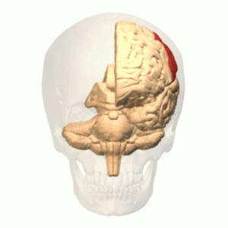
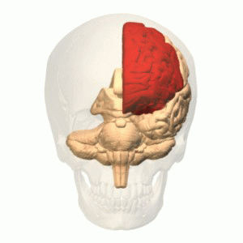
Stages of Alzheimer's
Prefrontal
Cortex
Notes:
Each side of your brain contains four lobes. Alzheimer’s disease starts in the hippocampus, deep within and part of the temporal lobe of the brain. The hippocampus is the structure responsible for creating new memories from our experiences. From the hippocampus the disease moves outward into the cerebral cortex, the outer layer of the brain, beginning in the temporal lobes. The temporal lobes, along with the prefrontal cortex, which is a part of the brain located at the front of the frontal lobe, play an important role in processing sounds and in language comprehension. Communication becomes difficult once this part of the brain in affected.
The frontal lobes and the prefrontal cortex are the parts of the human brain most associated with making us who we are. The frontal lobes lie directly behind the forehead and control voluntary movement like walking and finger tapping. It plays an important role in preserving memories. The frontal lobe contains the dopamine system which is associated with reward, attention, short-term memory tasks, planning, and motivation. It moderates responses so that our behavior is appropriate and acceptable in social situations.
The prefrontal cortex covers the forward part of the frontal lobes. It is responsible for our executive functioning. Many researchers believe it to be the center of our personality. Executive functions include our ability to differentiate between conflicting thoughts, between good and bad, for example. It is the prefrontal cortex that gives us the ability to choose between alternatives and to make decisions. It is the part of the brain that allows us to project possible future outcomes from current actions. Once Alzheimer’s disease progresses to this point a person will begin to lose the ability to care for himself or herself.
From the prefrontal cortex Alzheimer’s disease spreads toward the back of the brain, into the parietal, then the occipital lobes. These structures process much of the information coming in from our sense organs, and when these areas are damaged it becomes harder to make sense of the world.
Our sense of touch, the somatic sense, is located in the parietal lobe. It includes awareness of sensations like hunger, heat and cold, and the spatial awareness of our bodies (proprioception). The parietal lobes also play a role in language processing.
The occipital lobes contain the visual cortex, responsible for processing information coming from the eyes. Damage to the occipital lobe compromises visual perception, and often causes visual hallucinations.
Finally the disease reaches the base of the brain, the cerebellum and the brain stem. Located under the occipital lobes the cerebellum is responsible in large part for our kinesthetic sense, and controls balance and how we move.
The brainstem connects the brain with the spinal cord and is the conduit through which signals are passed back and forth between the brain and the body, including the organs. The brainstem is the last area to be affected, and when damage here becomes severe enough autonomic functions including breathing and heart rate will cease.

Slide 10
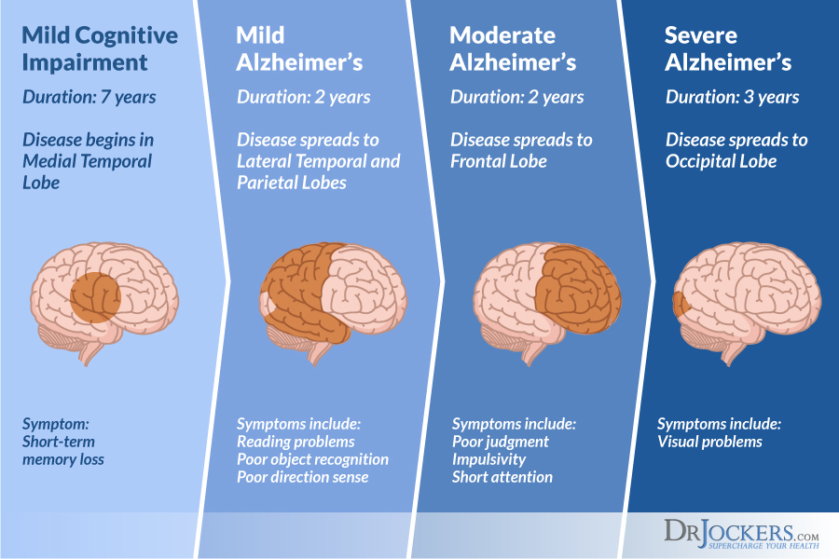
Stages of Alzheimer's
Notes:
People with MCI due to Alzheimer’s disease have biomarker evidence of Alzheimer’s brain changes (for example, abnormal levels of beta-amyloid) plus subtle problems with memory and thinking. These cognitive problems may be noticeable to family members and friends, but not to others, and they do not interfere with individuals’ ability to carry out everyday activities.
In the mild stage of Alzheimer’s dementia, most people are able to function independently in many areas but are likely to require assistance with some activities to maximize independence and remain safe. They may still be able to drive, work and participate in favorite activities.
In the moderate stage of Alzheimer’s dementia, which is often the longest stage, individuals may have difficulties communicating and performing routine tasks, including activities of daily living (such as bathing and dressing); become incontinent at times; and start having personality and behavioral changes, including suspiciousness and agitation.
In the severe stage of Alzheimer’s dementia, individuals need help with activities of daily living and are likely to require around-the-clock care. The effects of Alzheimer's disease on individuals’ physical health become especially apparent in this stage. Because of damage to areas of the brain involved in movement, individuals become bed-bound. Being bed-bound makes them vulnerable to conditions including blood clots, skin infections and sepsis, which triggers body-wide inflammation that can result in organ failure. Damage to areas of the brain that control swallowing makes it difficult to eat and drink. This can result in individuals swallowing food into the trachea (windpipe) instead of the esophagus (food pipe). Because of this, food particles may be deposited in the lungs and cause lung infection. This type of infection is called aspiration pneumonia, and it is a contributing cause of death among many individuals with Alzheimer’s.

Slide 11
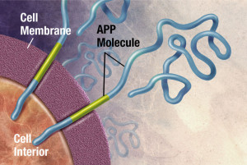
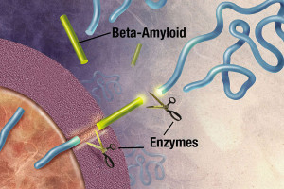
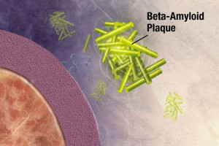
Pathological Causes of Alzheimer's Disease
Plaques are deposits of a protein fragment called beta-amyloid (BAY-tuh AM-uh-loyd) that build up in the spaces between nerve cells
Notes:
Brain accumulation of Aβ is believed to be the initial event of the AD process. The beta-amyloid protein involved in Alzheimer’s comes in several different molecular forms that collect between neurons. It is formed from the breakdown of a larger protein, called amyloid precursor protein. One form, beta-amyloid 42, is thought to be especially toxic. In the Alzheimer’s brain, abnormal levels of this naturally occurring protein clump together to form plaques that collect between neurons and disrupt cell function. Research is ongoing to better understand how, and at what stage of the disease, the various forms of beta-amyloid influence Alzheimer’s.
Aβ aggregates to form oligomers, protofibrils, fibrils and, ultimately, plaques, which are one of the hallmarks of AD pathology.
Plaques and smaller accumulations of beta-amyloid called oligomers may contribute to the damage and death of neurons (neurodegeneration) by interfering with neuron-to-neuron communication at synapses.

Slide 12
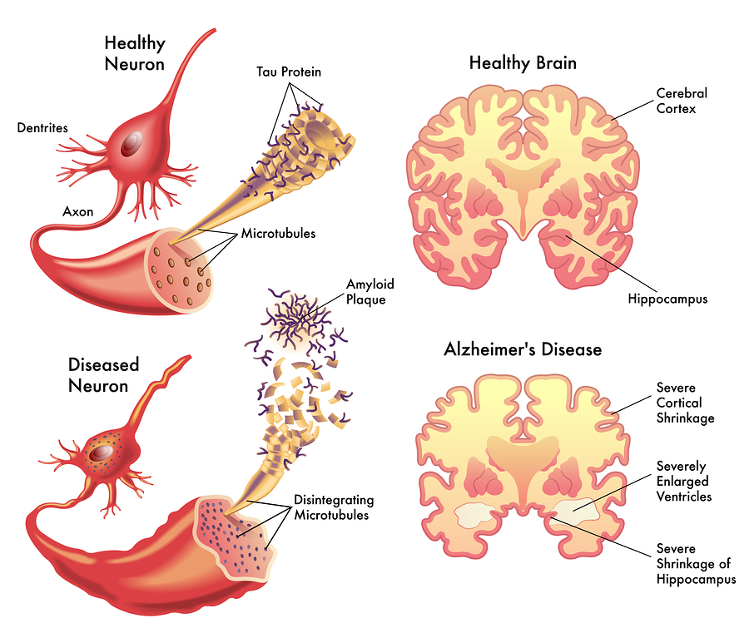
Pathological Causes of Alzheimer's Disease
Tangles are twisted fibers of another protein called tau (rhymes with “wow”) that build up inside cells
Notes:
Neurofibrillary tangles are abnormal accumulations of a protein called tau that collect inside neurons. Healthy neurons, in part, are supported internally by structures called microtubules, which help guide nutrients and molecules from the cell body to the axon and dendrites. In healthy neurons, tau normally binds to and stabilizes microtubules. In Alzheimer’s disease, however, abnormal chemical changes cause tau to detach from microtubules and stick to other tau molecules, forming threads that eventually join to form tangles inside neurons. These tangles block the neuron’s transport system, especially transport of nutrients and other essential molecules inside neurons, which harms the synaptic communication between neurons.
Although the complete sequence of events is unclear, beta-amyloid may begin accumulating before abnormal tau, and increasing beta-amyloid accumulation is associated with subsequent increases in tau.

Slide 13
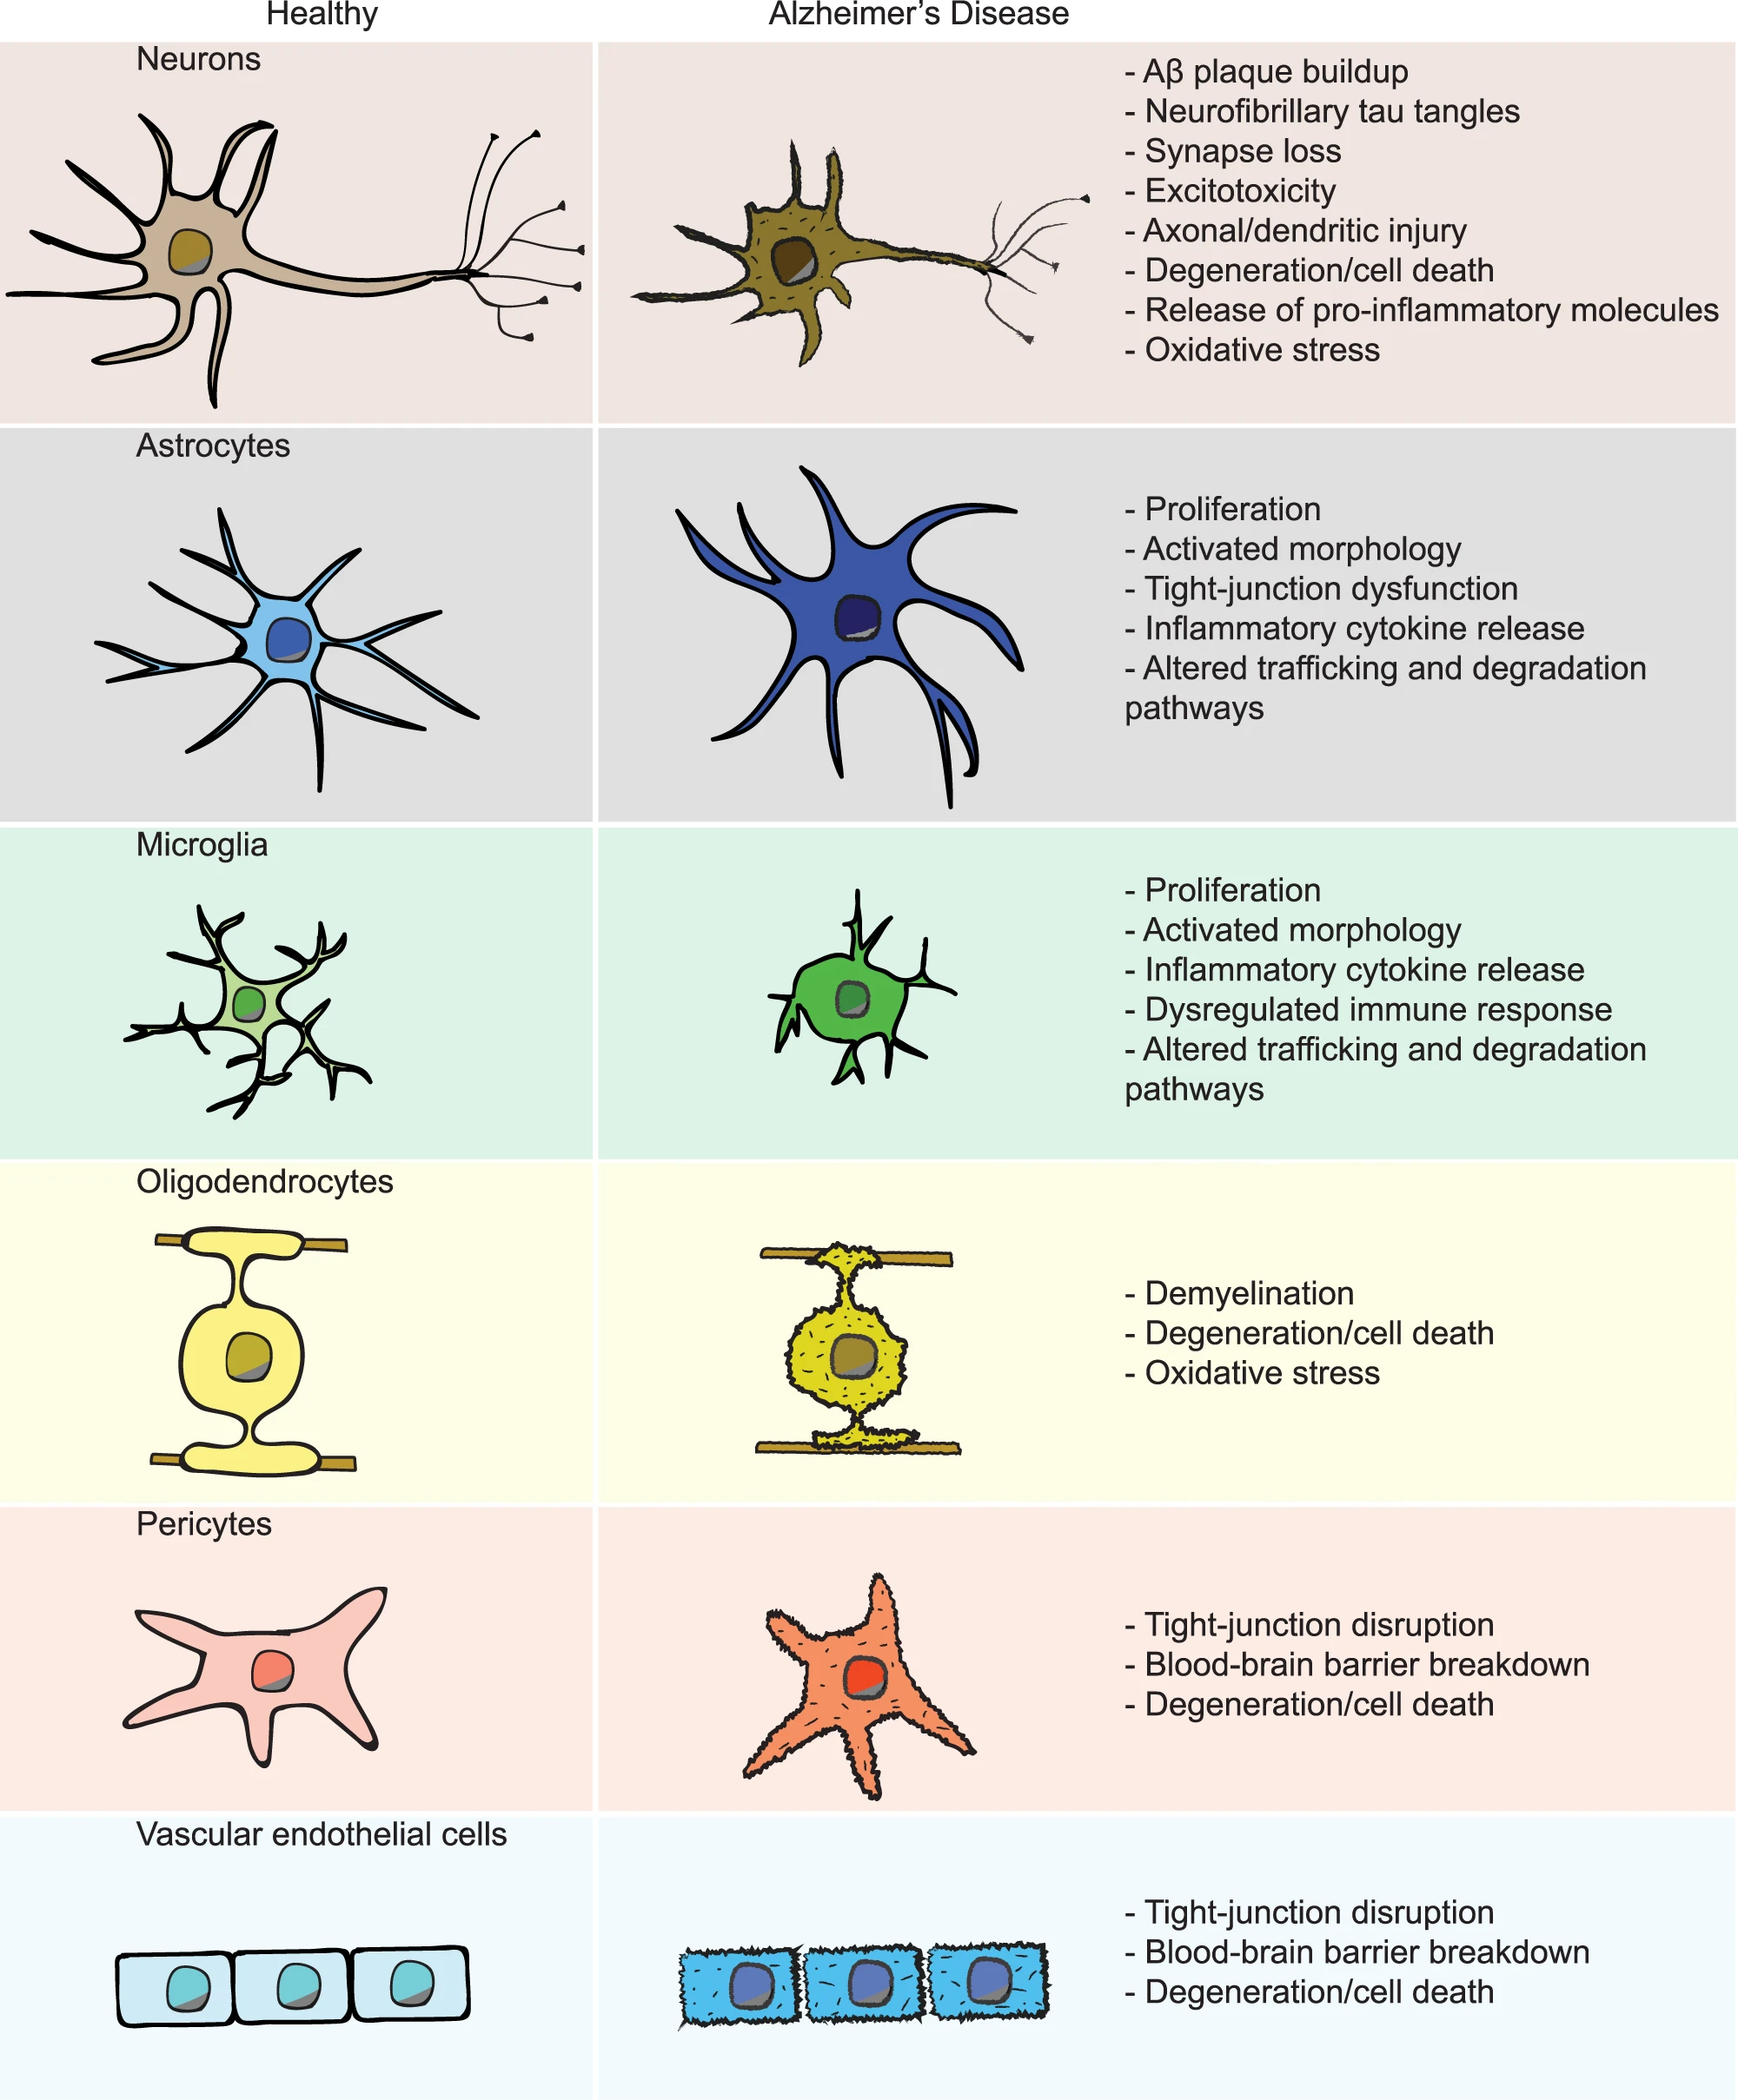
Pathological Causes of Alzheimer's Disease
Penney, J., Ralvenius, W.T. & Tsai, L. Modeling Alzheimer’s disease with iPSC-derived brain cells. Mol Psychiatry 25, 148–167 (2020). https://doi.org/10.1038/s41380-019-0468-3
Notes:
Neuron dysfunction and degeneration underlies a large part of cognitive decline during AD, but the brain also consists of many other non-neuronal cell types. These cells help to maintain proper brain function as well as ensuring the long-term health and survival of neurons. Oligodendrocytes insulate neuronal axons and promote fast synaptic transmission. Astrocytes and microglia closely associate with synapses, the sites of communication between neurons. Astrocytes, in addition to playing critical roles in neurotransmitter recycling, also perform important metabolic functions in the brain. Microglia, the resident innate immune cells of the brain, are involved in the pruning of synapses. Microglia also detect and remove invaders and debris, including pathogens, dying brain cells, cancerous cells and protein aggregates such as Aβ plaques. All of the mentioned glial cell types can also secrete pro- or anti-inflammatory factors and participate in clearance of toxic substances from the brain milieu. Aside from glia, the cells of the BBB form a physical impediment to the passage of most cells and molecules between the central nervous system and peripheral blood circulation. These blood vessels are composed of vascular endothelial cells (VECs), pericytes, and astrocytes that can break down during AD and exacerbate its progression.

Slide 14
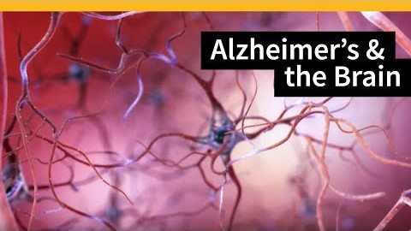
Pathological Causes of Alzheimer's Disease
https://youtu.be/0GXv3mHs9AU

Slide 15
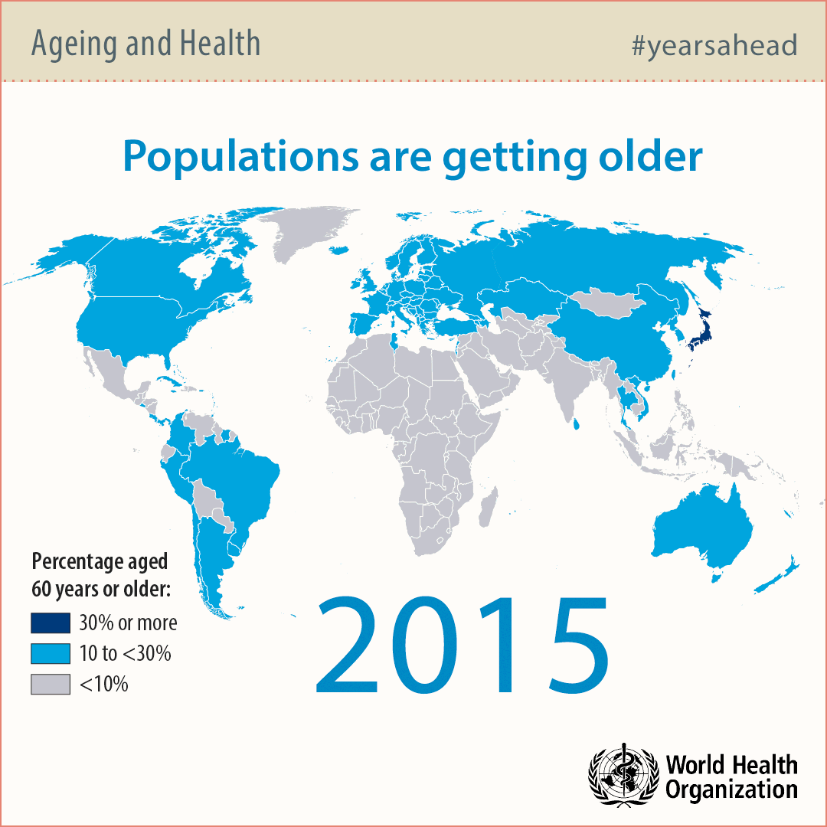
Notes:
Aging is the main risk factor for Alzheimer's disease. As the aging population continues to grow, the number of older people affected by AD will continue to increase.

Slide 16
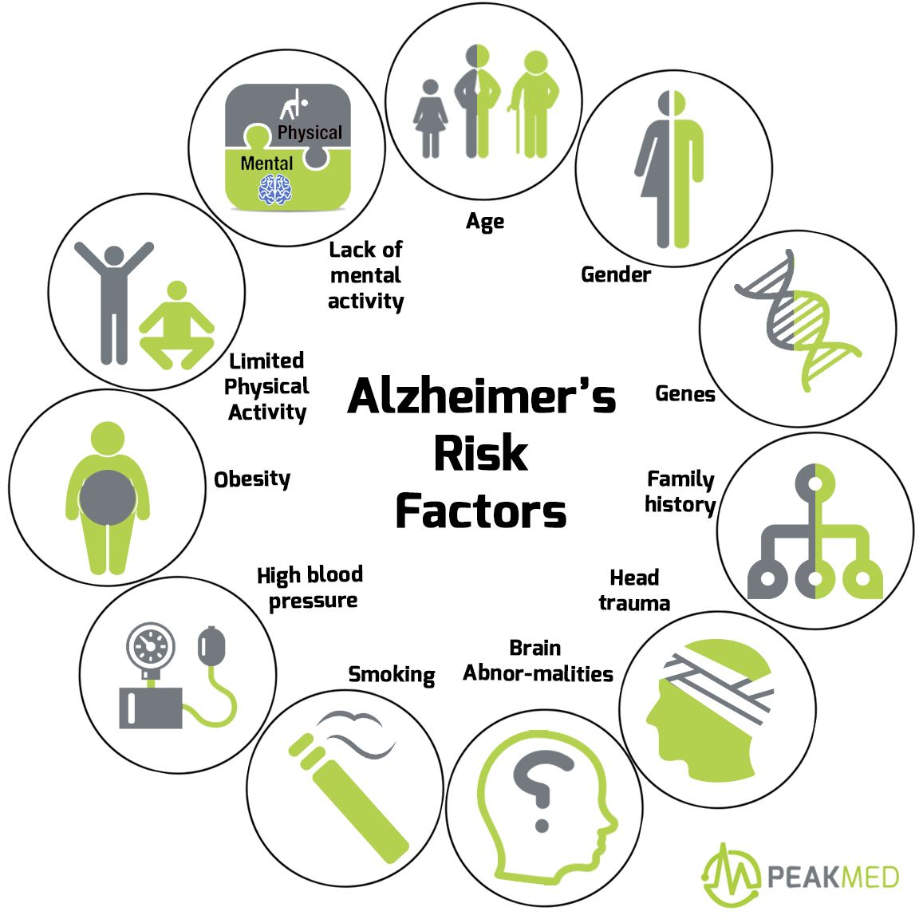
Risk Factors for Alzheimer's Disease
Age
Family History
Genetics (Heredity)
Lifestyle and Environment
Head Injury
Heart-Head Connection
Healthy Aging
Notes:
Age
The vast majority of people who develop Alzheimer’s dementia are age 65 or older. This is called late-onset Alzheimer’s. The greatest risk factors for late-onset Alzheimer’s are older age, genetics, and having a family history of Alzheimer’s.
Family History
Individuals who have a parent or sibling (first-degree relative) with Alzheimer’s dementia are more likely to develop the disease than those who do not have a first-degree relative with Alzheimer’s.
Genetics (Hereditary)
Researchers have found several genes that increase the risk of Alzheimer’s. The apolipoprotein-e4 (APOE-e4) gene is the gene with the strongest impact on risk of family history of Alzheimer’s. late-onset Alzheimer’s. APOE-e4 provides the blueprint for a protein that transports cholesterol in the bloodstream. Everyone inherits one of three forms (alleles) of the APOE gene — e2, e3 or e4 — from each parent, resulting in six possible APOE pairs: e2/e2, e2/e3, e2/e4, e3/e3, e3/e4 and e4/e4.
Lifestyle and Environment
Additional studies suggest that remaining socially and mentally active throughout life may support brain health and possibly reduce the risk of Alzheimer’s and other dementias. A focus on overall brain health to reduce cognitive decline may include: Exercise, Smoking cessation, Cardiovascular health, Low-fat/high vegetable and fruit diets, and Adequate sleep. Two diets that have been studied and may be beneficial to lowering the risk of Alzheimer's are the DASH (Dietary Approaches to Stop Hypertension) diet and the Mediterranean diet. The DASH diet emphasizes vegetables, fruits, fat-free or low-fat dairy products, whole grains, fish, poultry, beans, seeds, nuts and vegetable oils. The DASH diet limits sodium, sweets, sugary beverages and red meats. A Mediterranean diet includes relatively little red meat. It emphasizes whole grains, fruits and vegetables, fish and shellfish, and healthy fats like nuts and olive oil.
Certain environmental factors, like exposure to psychological stress, toxic chemicals, heavy metals and pesticides, polluted air, and brain injury, have been suggested to increase the risk of Alzheimer's, dementia
Head Injury
There appears to be a strong link between future risk of Alzheimer's and serious head trauma, especially when injury involves loss of consciousness. TBI is the disruption of normal brain function caused by a blow or jolt to the head or penetration of the skull by a foreign object. TBI increases the risk of dementia. The risk of dementia increases with the number of TBIs sustained. You can help reduce your risk of Alzheimer's and protect your head by: (1) Wearing a seat belt; (2) Using a helmet when participating in sports; and (3) "Fall-proofing" your home by minimizing clutter, loose rugs and poor lighting.
Head-Heart Connection
Brain health is affected by the health of the heart and blood vessels. A healthy heart ensures that enough blood is pumped to the brain, while healthy blood vessels enable the oxygen- and nutrient-rich blood to reach the brain so it can function normally. Several conditions known to increase the risk of cardiovascular disease — such as smoking, high blood pressure, diabetes, obesity, and high cholesterol — also increase the risk of developing Alzheimer’s.
Healthy Aging
One promising line of research suggests that strategies for overall healthy aging may help keep the brain healthy and may even reduce the risk of developing Alzheimer’s and other dementias. These measures include eating a healthy diet, staying socially active, avoiding tobacco and excess alcohol, and exercising both the body and mind.

Slide 17
How Is Alzheimer’s Disease Diagnosed?
Medical history
Mental status tests
Physical exams
Neurological exams
Diagnostic or genetic tests
Brain imaging
Notes:
There is no single diagnostic test that can determine if a person has Alzheimer’s disease. Physicians (often with the help of specialists such as neurologists, neuropsychologists, geriatricians and geriatric psychiatrists) use a variety of approaches and tools to help make a diagnosis.
Medical History
Your health care provider will review your medical history, including psychiatric history and history of cognitive and behavioral changes. He or she will want to know about any current and past illnesses, as well as any medications you are taking. The doctor will also ask about key medical conditions affecting other family members, including whether they may have had Alzheimer's disease or other dementias.
Mental Status Tests
Mental status testing evaluates memory, ability to solve simple problems and other thinking skills. Such tests give an overall sense of whether a person: (1) Is aware of symptoms; (2) Knows the date, time, and where he or she is; and (3) Can remember a short list of words, follow instructions and do simple calculations.
Physical Exams
Information from a physical exam and laboratory tests can help identify health issues that can cause symptoms of dementia. Common causes of dementia-like symptoms are depression, untreated sleep apnea, delirium, side effects of medications, thyroid problems, certain vitamin deficiencies and excessive alcohol consumption. Unlike Alzheimer’s, these conditions often may be reversed with treatment. During a physical exam, you can expect the physician to: (1) Ask about diet, nutrition and use of alcohol; (2) Review all medications currently being taken, including over-the-counter drugs and supplements; (3) Check blood pressure, temperature and pulse; (4) Listen to the heart and lungs; (5) Perform other procedures to assess overall health; and (6) Collect blood or urine samples for laboratory testing.
Neurological Exams
During a neurological exam, the physician will closely evaluate the person for problems that may signal brain disorders other than Alzheimer's. The doctor will look for signs of small or large strokes, Parkinson's disease, brain tumors, fluid accumulation on the brain, and other illnesses that may impair memory or thinking. The physician will test: Reflexes, Coordination, muscle tone and strength, Eye movement, Speech, and Sensation.
Diagnostic or Genetic Tests
A small percentage of Alzheimer’s cases — an estimated 1 percent or less — are caused by specific mutations in one of three genes: the gene for the amyloid precursor protein, the gene for the presenilin 1 protein or the gene for the presenilin 2 protein. A genetic mutation is an abnormal change in the sequence of chemical pairs that make up genes. Genes with these specific mutations are considered to be “deterministic genes,” meaning that inheriting one of the genes virtually guarantees that an individual will develop Alzheimer’s disease.
Brain Imaging
A standard medical workup for Alzheimer's disease often includes structural imaging with magnetic resonance imaging (MRI) or computed tomography (CT). These tests are primarily used to rule out other conditions that may cause symptoms similar to Alzheimer's but require different treatment. Structural imaging can reveal tumors, evidence of small or large strokes, damage from severe head trauma, or a buildup of fluid in the brain.

Slide 18
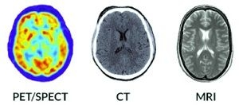
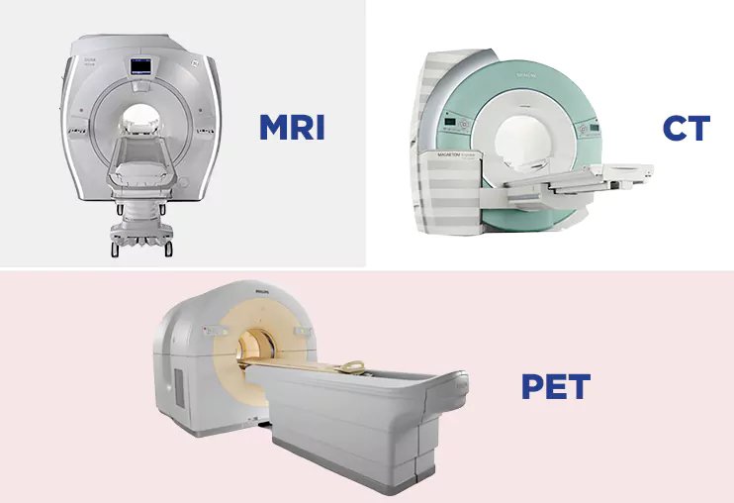
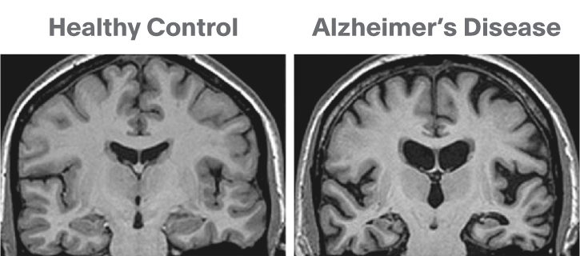
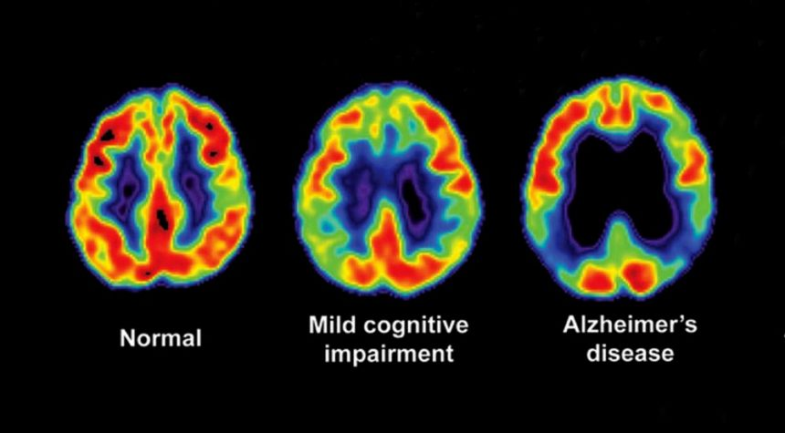
Technological Advances in AD Research
Brain Imaging
Computed Tomography
Magnetic Resonance Imaging
SFM
S
Positron Emission Tomography
S = Structural
F = Functional
M = Molecular
FM
Notes:
Structural imaging provides information about the shape, position or volume of brain tissue. Structural techniques include magnetic resonance imaging (MRI) and computed tomography (CT) or computed axial tomography (CAT).
Functional imaging reveals how well cells in various brain regions are working by showing how actively the cells use sugar or oxygen. Functional techniques include positron emission tomography (PET) and functional MRI (fMRI). Functional imaging research suggests that those with Alzheimer's typically have reduced brain cell activity in certain regions.
Molecular imaging uses highly targeted radiotracers to detect cellular or chemical changes linked to specific diseases. Molecular imaging technologies include PET, fMRI and single photon emission computed tomography (SPECT). Molecular strategies may detect biological clues indicating Alzheimer's is under way before the disease changes the brain's structure or function, or takes an irreversible toll on memory, thinking and reasoning.
Even though amyloid plaques in the brain are a characteristic feature of Alzheimer's disease, their presence cannot be used to diagnose the disease. Many people have amyloid plaques in the brain but have no symptoms of cognitive decline or Alzheimer's. Because amyloid plaques cannot be used to diagnose Alzheimer's, amyloid imaging is not recommended for routine use in patients suspected of having the disease.
MRI (30-45 min)
Magnetic resonance imaging (MRI) of the brain is a safe and painless test that uses a magnetic field and radio waves to produce detailed images of the brain and the brain stem. An MRI differs from a CAT scan (also called a CT scan or a computed axial tomography scan) because it does not use radiation. An MRI scanner consists of a large doughnut-shaped magnet that often has a tunnel in the center. Patients are placed on a table that slides into the tunnel.
During the exam, radio waves manipulate the magnetic position of the atoms of the body, which are picked up by a powerful antenna and sent to a computer. The computer performs millions of calculations, resulting in clear, cross-sectional black and white images of the body. These images can be converted into three-dimensional (3-D) pictures of the scanned area. This helps pinpoint problems in the brain and the brain stem when the scan focuses on those areas.
MRI can detect a variety of conditions of the brain such as cysts, tumors, bleeding, swelling, developmental and structural abnormalities, infections, inflammatory conditions, or problems with the blood vessels. It can determine if a shunt is working and detect damage to the brain caused by an injury or a stroke.
MRI of the brain can be useful in evaluating problems such as persistent headaches, dizziness, weakness, and blurry vision or seizures, and it can help to detect certain chronic diseases of the nervous system, such as multiple sclerosis.
In some cases, MRI can provide clear images of parts of the brain that can't be seen as well with an X-ray, CAT scan, or ultrasound, making it particularly valuable for diagnosing problems with the pituitary gland and brain stem.
CT or CAT (10 min)
A CAT scan of the head (also called a head CT) is a painless test that uses a special X-ray machine to take pictures of a patient's brain, skull, and sinuses, as well as blood vessels in the head.
The doughnut-shaped machine circles the head, taking pictures to provide cross-sections of the brain from various angles. These pictures are sent to a computer that records the images. It also can put them together to form three-dimensional images.
A head CAT scan may be done in order to:
detect conditions in the brain such as hydrocephalus (too much fluid in the ventricles), swelling, inflammation, bleeding, and signs of injury
gather information about the presence, location, and size of abscesses, cysts, and tumors
locate birth defects in the brain and skull
evaluate the pituitary gland, pineal gland, and sinuses
look at malformed or injured blood vessels in the head
find the cause of headaches, weakness, or a change in mental status
PET (30 to 60 minutes for the tracer to be absorbed by your body; 30 minutes to complete the test)
Positron emission tomography (PET) is a type of nuclear medicine procedure that measures metabolic activity of the cells of body tissues. PET is actually a combination of nuclear medicine and biochemical analysis. Used mostly in patients with brain or heart conditions and cancer, PET helps to visualize the biochemical changes taking place in the body, such as the metabolism (the process by which cells change food into energy after food is digested and absorbed into the blood) of the heart muscle.
PET differs from other nuclear medicine examinations in that PET detects metabolism within body tissues, whereas other types of nuclear medicine examinations detect the amount of a radioactive substance collected in body tissue in a certain location to examine the tissue's function.
Since PET is a type of nuclear medicine procedure, this means that a tiny amount of a radioactive substance, called a radiopharmaceutical (radionuclide or radioactive tracer), is used during the procedure to assist in the examination of the tissue under study. Specifically, PET studies evaluate the metabolism of a particular organ or tissue, so that information about the physiology (functionality) and anatomy (structure) of the organ or tissue is evaluated, as well as its biochemical properties. Thus, PET may detect biochemical changes in an organ or tissue that can identify the onset of a disease process before anatomical changes related to the disease can be seen with other imaging processes such as computed tomography (CT) or magnetic resonance imaging (MRI).
PET may also be used in conjunction with other diagnostic tests, such as computed tomography (CT) or magnetic resonance imaging (MRI) to provide more definitive information about malignant (cancerous) tumors and other lesions. Newer technology combines PET and CT into one scanner, known as PET/CT. PET/CT shows particular promise in the diagnosis and treatment of lung cancer, evaluating epilepsy, Alzheimer's disease and coronary artery disease.
PET works by using a scanning device (a machine with a large hole at its center) to detect photons (subatomic particles) emitted by a radionuclide in the organ or tissue being examined.
The radionuclides used in PET scans are made by attaching a radioactive atom to chemical substances that are used naturally by the particular organ or tissue during its metabolic process.
The radionuclide is administered into a vein through an intravenous (IV) line. Next, the PET scanner slowly moves over the part of the body being examined. Positrons are emitted by the breakdown of the radionuclide. Gamma rays are created during the emission of positrons, and the scanner then detects the gamma rays. A computer analyzes the gamma rays and uses the information to create an image map of the organ or tissue being studied. The amount of the radionuclide collected in the tissue affects how brightly the tissue appears on the image and indicates the level of organ or tissue function.
In general, PET scans may be used to evaluate organs and/or tissues for the presence of disease or other conditions. PET may also be used to evaluate the function of organs, such as the heart or brain. The most common use of PET is in the detection of cancer and the evaluation of cancer treatment.
More specific reasons for PET scans include, but are not limited to, the following:
To diagnose dementias (conditions that involve deterioration of mental function), such as Alzheimer's disease, as well as other neurological conditions such as:
Parkinson's disease. A progressive disease of the nervous system in which a fine tremor, muscle weakness, and a peculiar type of gait are seen.
Huntington's disease. A hereditary disease of the nervous system which causes increasing dementia, bizarre involuntary movements, and abnormal posture.
Epilepsy. A brain disorder involving recurrent seizures.
Cerebrovascular accident (stroke)
To locate the specific surgical site prior to surgical procedures of the brain
To evaluate the brain after trauma to detect hematoma (blood clot), bleeding, and/or perfusion (blood and oxygen flow) of the brain tissue
To detect the spread of cancer to other parts of the body from the original cancer site
To evaluate the effectiveness of cancer treatment
To evaluate the perfusion (blood flow) to the myocardium (heart muscle) as an aid in determining the usefulness of a therapeutic procedure to improve blood flow to the myocardium
To further identify lung lesions or masses detected on chest X-ray and/or chest CT
To assist in the management and treatment of lung cancer by staging lesions and following the progress of lesions after treatment
To detect recurrence of tumors earlier than with other diagnostic modalities

Slide 19
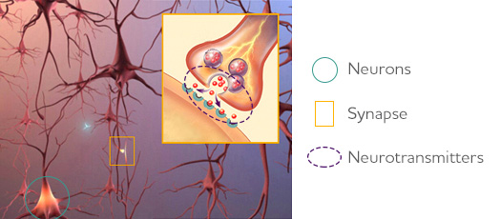
How Is Alzheimer’s Disease Treated?
Source: Alzheimer’s Association (https://www.alz.org/)
Notes:
Alzheimer's has no current cure, but treatments for symptoms are available and research continues. Although current Alzheimer's treatments cannot stop Alzheimer's from progressing, they can temporarily slow the worsening of dementia symptoms and improve quality of life for those with Alzheimer's and their caregivers.
To understand how Alzheimer's medications work, you first need to understand the communication network in the brain. The picture below depicts nerve cells, or neurons, in the brain. Neurons are the chief cells destroyed by Alzheimer's disease.
In the brain, neurons connect and communicate at synapses, where tiny bursts of chemicals called neurotransmitters carry information from one cell to another. Alzheimer's disrupts this process, and eventually destroys synapses and kills neurons, damaging the brain's communication network.

Slide 20
How Is Alzheimer’s Disease Treated?
GENERIC | BRAND | APPROVED FOR | SIDE EFFECTS
Donepezil | Aricept | All stages | Nausea, vomiting, loss of appetite, muscle cramps and increased frequency of bowel movements.
Galantamine | Razadyne | Mild to moderate | Nausea, vomiting, loss of appetite and increased frequency of bowel movements.
Memantine | Namenda | Moderate to severe | Headache, constipation, confusion and dizziness.
Rivastigmine | Exelon | Mild to moderate | Nausea, vomiting, loss of appetite and increased frequency of bowel movements.
Memantine + Donepezil | Namzaric | Moderate to severe | Nausea, vomiting, loss of appetite, increased frequency of bowel movements, headache, constipation, confusion and dizziness.
Notes:
As Alzheimer’s progresses, brain cells die and connections among cells are lost, causing cognitive symptoms to worsen. While current medications cannot stop the damage Alzheimer’s causes to brain cells, they may help lessen or stabilize symptoms for a limited time by affecting certain chemicals involved in carrying messages among the brain's nerve cells.
The U.S. Food and Drug Administration (FDA) has approved two types of medications — cholinesterase inhibitors (Aricept®, Exelon®, Razadyne®) and memantine (Namenda®) — to treat the cognitive symptoms (memory loss, confusion, and problems with thinking and reasoning) of Alzheimer's disease.
cholinesterase inhibitors: Prevent the breakdown of acetylcholine (a-SEA-til-KOH-lean), a chemical messenger important for learning and memory. This supports communication among nerve cells by keeping acetylcholine high. Cholinesterase inhibitors are prescribed to treat symptoms related to memory, thinking, language, judgment and other thought processes.
Memantine is prescribed to improve memory, attention, reason, language and the ability to perform simple tasks. It regulates the activity of glutamate, a chemical involved in information processing, storage and retrieval.

Slide 21
How Is Alzheimer’s Disease Treated?
Treatments for Behavior Changes
  Wandering, agitation, anxiety, depression, aggression, anger, etc.
Treatments for Sleep Changes
Alternative Treatments
  Caprylic acid (Axona®)
  Coenzyme Q10 or ubiquinone
  “Coral” calcium supplements
  Ginkgo biloba
  Huperzine A
  Omega-3 fatty acids
  Phosphatidylserine
  Tramiprosate
Notes:
Many people find the changes in behavior caused by Alzheimer's to be the most challenging and distressing effect of the disease. The chief cause of behavioral symptoms is the progressive deterioration of brain cells. If non-drug approaches fail after being applied consistently, introducing medications may be appropriate for individuals with severe symptoms or who have the potential to harm themselves or others.
People with Alzheimer’s often have problems with sleeping or may experience changes in their sleep schedule. In some cases, non-drug approaches fail to work or the sleep changes are accompanied by disruptive nighttime behaviors. In these cases, medications used to treat sleep changes are prescribed.
A growing number of herbal remedies, dietary supplements and "medical foods" are promoted as memory enhancers or treatments to delay or prevent Alzheimer’s disease. Although some of these remedies may be valid candidates for treatments, there are legitimate concerns about using these drugs as an alternative or in addition to physician-prescribed therapy: (1) Effectiveness and safety are unknown; (2) Purity is unknown; and (3) Dietary supplements can have serious interactions with prescribed medications.

Slide 22

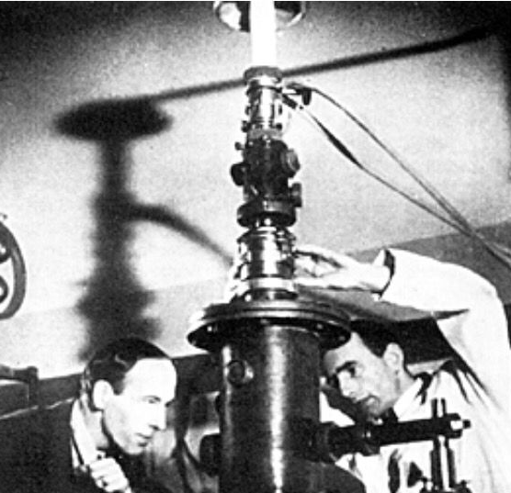
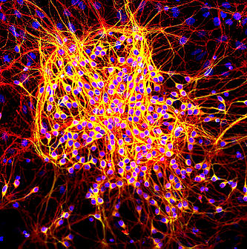
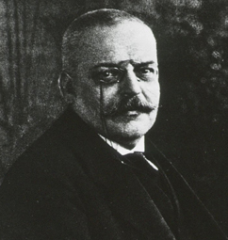
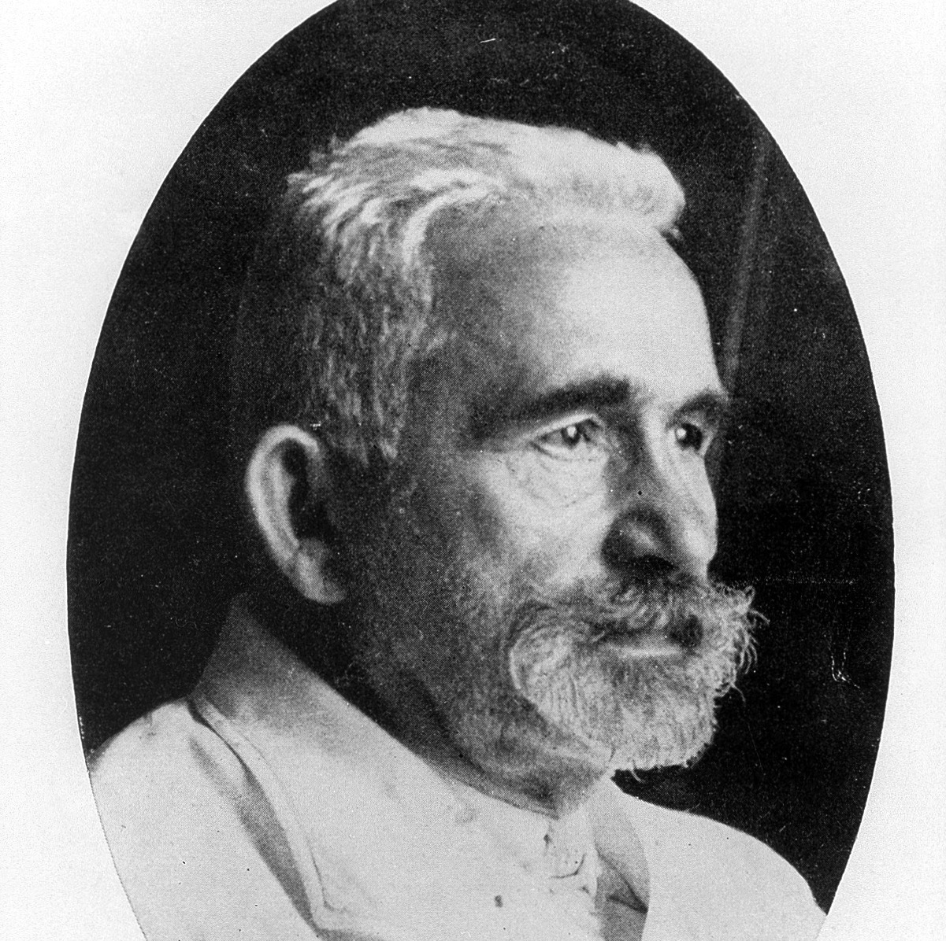
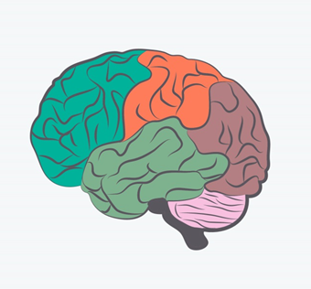

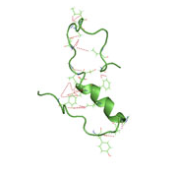
History of Alzheimer disease
1976
AD Recognized as
Most Common Form
of Dementia
1931
Dr. Max Knoll & Dr. Ernst Ruska
Co-invents Electron Microscope
1986
Tau Protein
Identified
1906
Dr. Alois Alzheimer
1st Describes AD
1900
1910
Dr. Emil Kraeplin
1st Names AD
1968
Cognitive Measures
Developed
1987
1st AD Drug Trial &
AD Gene Identified
1984
Dr. George Glenner &
Dr. Cai’ne Wong Identifies
Beta-amyloid
Source: Alzheimer’s Association (https://www.alz.org/)
Notes:
1906
German physician Alois Alzheimer first describes AD as "a peculiar disease.“ He linked symptoms to microscopic brain changes. He described the case of a patient who had profound memory loss, and psychological changes. In her brain at autopsy, he saw dramatic shrinkage and abnormal deposits in and around nerve cells.
1910
Emil Kraepelin, a German psychiatrist who worked with Dr. Alzheimer, first names "Alzheimer's Disease."
1931
In 1931, Germans Max Knoll and Ernst Ruska co-invent the electron microscope, which can magnify up to 1 million times. It is not until after WWII that the electron microscope becomes common in major research settings, enabling scientists to study brain cells in more detail.
1968
Researchers develop the first validated measurement scale for assessing cognitive and functional decline in older adults, paving the way to correlate the level of measured impairment with estimates of the number of brain lesions and the volume of damaged tissue.
1976
Neurologist Robert Katzman identifies Alzheimer's disease as the most common cause of dementia and a major public health challenge in his editorial published in Archives of Neurology.
1984
Researchers George Glenner and Cai'ne Wong report identification of "a novel cerebrovascular amyloid protein," known as beta-amyloid — the chief component of Alzheimer's brain plaques and a prime suspect in triggering nerve cell damage.
1986
Researchers discover that tau protein is a key component of tangles — the second pathological hallmark of Alzheimer's disease and another prime suspect in nerve cell degeneration.
1987
The Alzheimer's Association assists the NIA and Warner-Lambert Pharmaceutical Company (now Pfizer) in launching and recruiting participants for clinical trials of tacrine, the first drug specifically targeting symptoms of Alzheimer's disease.
Researchers identify the first gene associated with rare, inherited forms of Alzheimer's disease. This gene on chromosome 21 codes amyloid precursor protein (APP), the parent molecule from which beta-amyloid is formed.

Slide 23

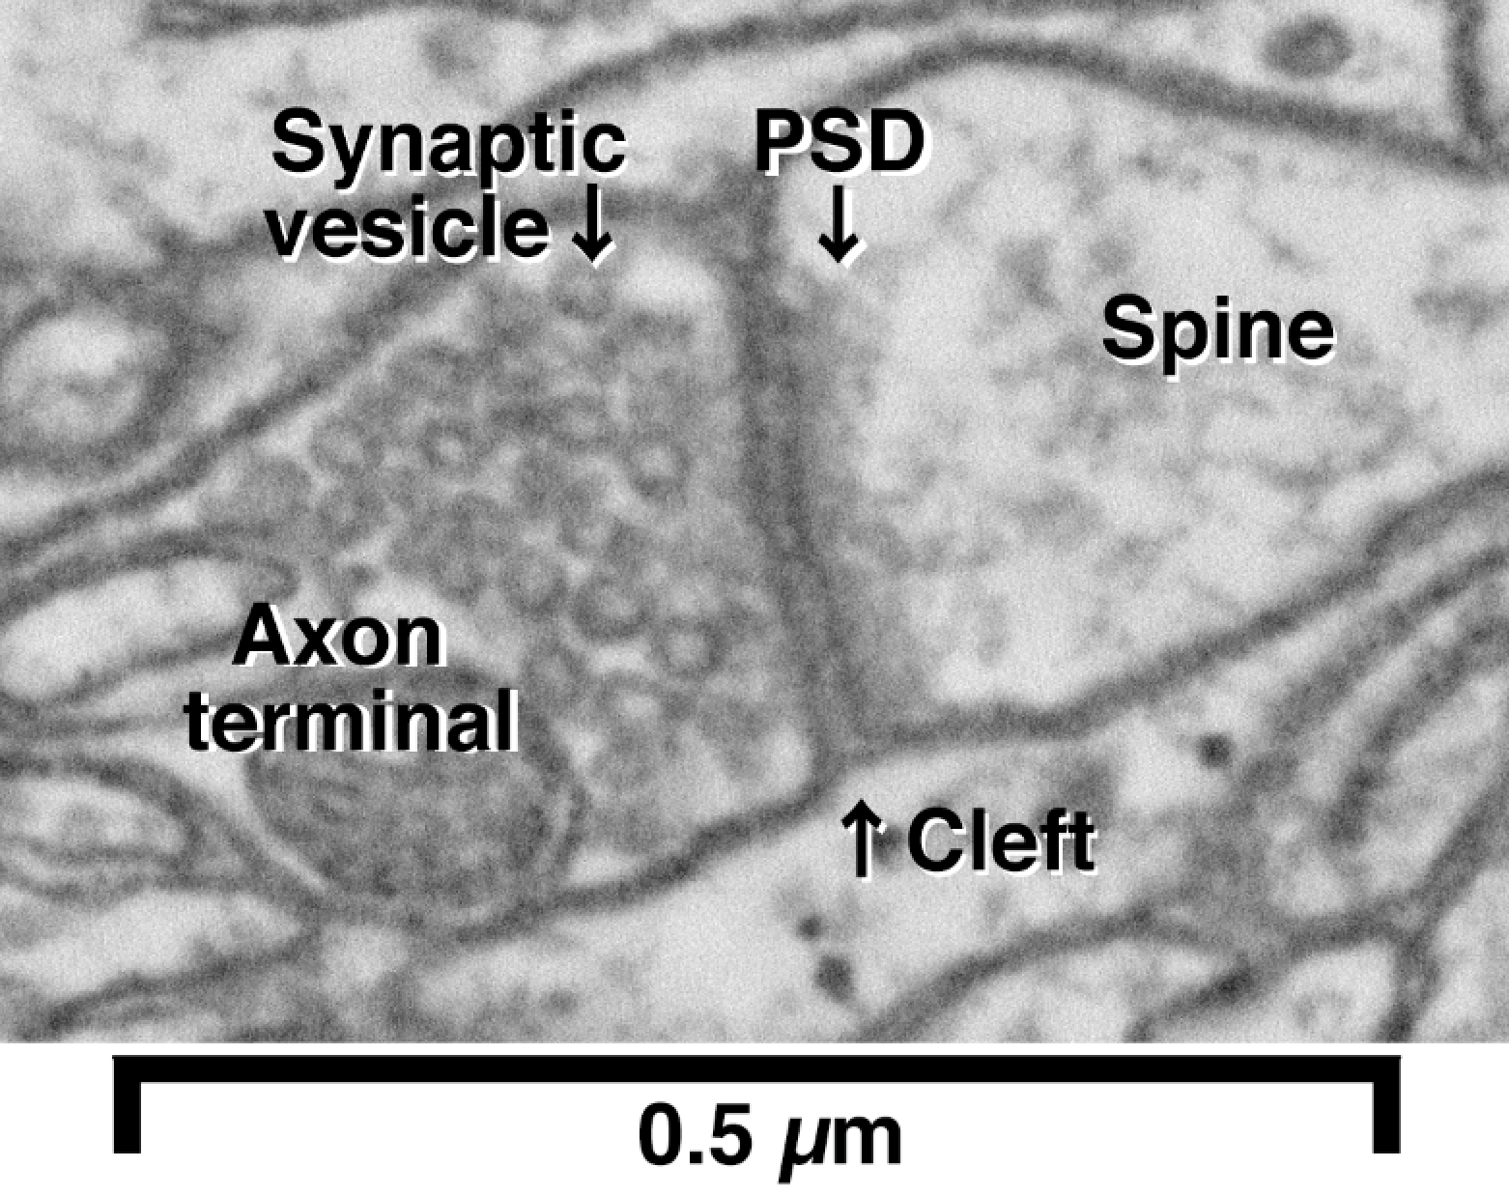
Technological Advances in AD Research
Microscopy
Notes:
Electron microscopy (EM) is a technique for obtaining high resolution images of biological and non-biological specimens. It is used in biomedical research to investigate the detailed structure of tissues, cells, organelles and macromolecular complexes. Electron microscopy has enlarged the visual horizons of the morphological alterations in Alzheimer's disease (AD). Study of the mitochondria and Golgi apparatus in early cases of AD revealed the principal role that these important organelles play in the drama of pathogenic dialog of AD, substantially affecting energy production and supply, and protein trafficking in neurons and glia. In addition, study of the morphological alterations of the dendritic arbor, dendritic spines and neuronal synapses, which are associated with mitochondrial damage, may reasonably interpret the clinical phenomena of the irreversible decline of the mental faculties and an individual's personality changes. Electron microscopy also reveals the involvement of microvascular alterations in the etiopathogenic background of AD.

Slide 24
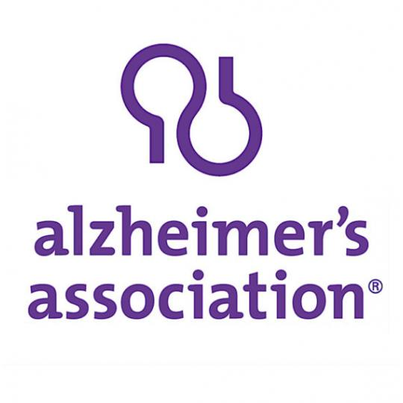


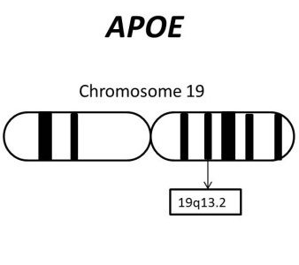
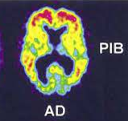

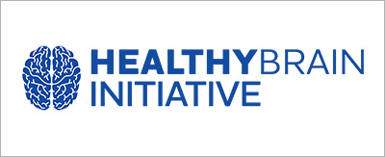
History of Alzheimer disease
2009
QC Program for
CSF Biomarkers Launched
1999
AD Vaccine
Successful in Mice
2013
New Genetic Risk Factors
for AD Identified
1993
1st AD Risk Factor
Gene (APOE-e4)
Identified & Drug
Approved by FDA
(Tacrine/Cognex)
2004
1st Report on
Imaging Agent
(Pittsburgh
Compound B)
& AD Neuro-
imaging Initiative
2018
Dementia Care Practice
Recommendations Published
1990
2019
International Research
Network Established
2003
National AD
Genetics
Study Begins
1995
1st Transgenic Mouse
for AD Developed
2008
AA & CDC Launch
Road Map to Prevent
Cognitive Impairment
2010
AD Clinical Trial
Database Established,
TrialMatch® Launched, &
Biomarker Changes in AD Discovered
Source: Alzheimer’s Association (https://www.alz.org/)
Notes:
1993
Researchers identify APOE-e4, a form of the apolipoprotein-E (APOE) gene on chromosome 19, as the first gene that raises risk for Alzheimer's but does not determine that a person who has it will develop the disease.
The Food and Drug Administration (FDA) approves tacrine (Cognex) as the first drug specifically targeting Alzheimer's memory and thinking symptoms. Four additional drugs are approved over the next 10 year
1995
Researchers announce the first transgenic mouse model that developed Alzheimer-like brain pathology. The mouse was developed by inserting one of the human APP genes linked to a rare, inherited form of Alzheimer's disease.
1999
The first in a series of reports is published showing that injecting transgenic "Alzheimer" mice with beta-amyloid prevents the animals from developing plaques and other Alzheimer-like brain changes.
2003
The Alzheimer's Association partners with the National Institute on Aging to recruit participants for the National Alzheimer's Disease Genetics Study, a federal initiative to collect and bank blood samples from families with several members who developed Alzheimer's disease late in life in order to identify additional Alzheimer's risk genes.
2004
Researchers at the Alzheimer's Association International Conference on Alzheimer's Disease (AAICAD) share their first report on an imaging agent called Pittsburgh Compound B (PIB), a major potential breakthrough in disease monitoring and early detection. PIB enters the brain through the bloodstream and attaches itself to beta-amyloid deposits, where it can be detected by positron emission tomography (PET).
The Alzheimer's Association joins public and private donors as a major sponsor of the Alzheimer's Disease Neuroimaging Initiative (ADNI), a nationwide study to establish standards for obtaining and interpreting brain images. The ultimate goal of ADNI is to determine whether standardized images, possibly combined with laboratory and psychological tests, can identify high-risk individuals; provide early detection; and track and monitor treatment effects, especially in clinical trials of disease-modifying drugs.
2008
The Alzheimer’s Association and the U.S. Centers for Disease Control and Prevention launch the Healthy Brain Initiative with the publication of A National Public Health Road Map to Maintaining Cognitive Health. The Road Map advances 44 science-based actions emphasizing primary prevention of cognitive impairment. The goal of this initiative is to maintain or improve the cognitive performance of all adults.
2009
The Alzheimer's Association announces funding of the Alzheimer's Association QC Program for CSF Biomarkers to help overcome variation among institutions in measuring potential biomarkers in cerebrospinal fluid (CSF).
2010
The Alzheimer's Association and its partners in the Coalition Against Major Diseases (CAMD) released a first-of-its kind database of 4,000 patients who participated in 11 pharmaceutical industry-sponsored clinical trials of Alzheimer's treatments. The combined data, accessible to any qualified researcher, will offer unprecedented power to understand the course of Alzheimer’s.
The Association launches TrialMatch®, a free, easy-to-use clinical studies matching service that connects individuals living with Alzheimer's disease, caregivers, and healthy volunteers with current research studies.
A group of researchers publish a working model relating changes in Alzheimer’s biomarkers to disease stage and symptom severity.
2013
Hundreds of researchers from around the world collaborate to perform a meta-analysis of genome-wide association studies intended to identify genetic variations linked with an increased risk for Alzheimer’s disease. The collaboration revealed 20 genetic variations associated with increased risk, 11 of which had not been linked with Alzheimer’s before. Some of the newly identified genetic variations are thought to be specific to the immune system, adding to mounting evidence of a role for the immune system in Alzheimer’s disease.
2018
Alzheimer’s Association released Dementia Care Practice Recommendations aimed at helping professional care providers deliver optimal quality, person-centered care for those living with Alzheimer’s and other dementias.
2019
The National Institutes of Health (NIH) awarded the Alzheimer’s Association $1.34 million over five years for an international research network, Leveraging an Interdisciplinary Consortium to Improve Care and Outcomes for Persons Living with Alzheimer’s and Dementia (LINC-AD), to improve care and psychosocial outcomes for individuals living with dementia.

Slide 25
AD Milestones in Infrastructure, Policy, & Law
1974 – Congress established the National Institute of Aging
1980 – Alzheimer's Association founded
1983 – November declared National AD Month
2008 - International Society to Advance Alzheimer's Research and Treatment formed
2011 – President Obama signs National Alzheimer’s Project Act
2015 - Alzheimer's Accountability Act signed into law
Notes:
1974
An act of Congress establishes the National Institute on Aging (NIA) as one of our National Institutes of Health (NIH). The NIA is our primary federal agency supporting Alzheimer's research.
1980
In 1979, Jerome H. Stone and representatives from several family support groups met with the National Institute on Aging to explore the value of a national, independent, nonprofit organization to complement and stimulate federal efforts on Alzheimer's disease. That meeting resulted in the 1980 formation of the Alzheimer's Association with Mr. Stone as founding president. Today, the Alzheimer’s Association is the leading voluntary health organization in Alzheimer’s care, support and research.
1983
Awareness of Alzheimer's disease increases, leading Congress to designate November 1983 as the first National Alzheimer's Disease Month.
2008
To further the work of the global Alzheimer's research community, the Alzheimer's Association creates the International Society to Advance Alzheimer's Research and Treatment (ISTAART), the first and only professional society dedicated to Alzheimer's and dementia.
2011
Groundbreaking legislation establishes our first-ever framework for a national strategic plan to address the Alzheimer's crisis and to coordinate our response on multiple fronts, including research, care and support.
2015
The Alzheimer's Association led the fight for this law that allows scientists at the NIH to submit an annual research budget directly to Congress.

Slide 26
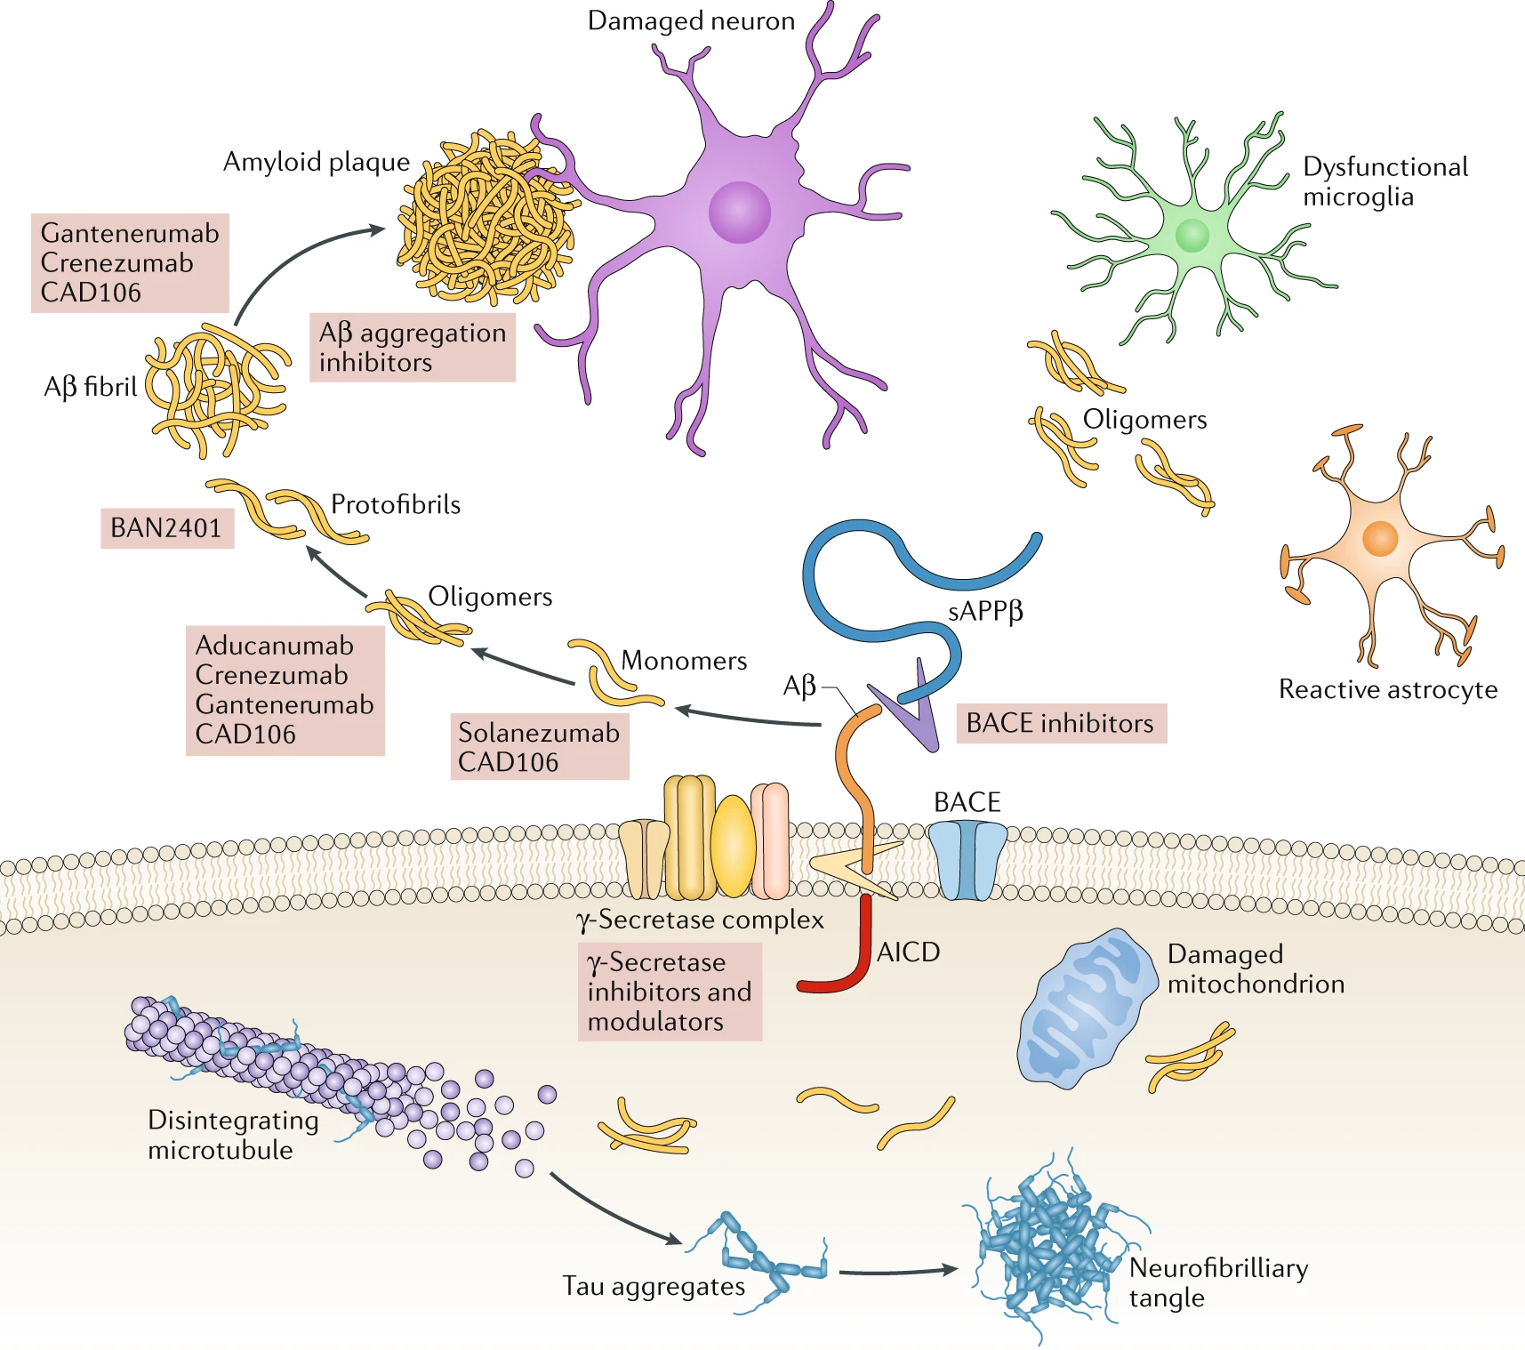
Where Are We Now for AD Research?
Panza, F., Lozupone, M., Logroscino, G. et al. A critical appraisal of amyloid-β-targeting therapies for Alzheimer disease. Nat Rev Neurol 15, 73–88 (2019). https://doi.org/10.1038/s41582-018-0116-6
Notes:
Most of the drugs tested for AD in the past 20 years have targeted the accumulation of the amyloid-β (Aβ) peptide. This figure illustrates the mechanisms of action of the main anti-amyloid-β (Aβ) drugs that are currently in phase III clinical development for the treatment of Alzheimer disease.

Slide 27
Where Are We Now for AD Research?
Tau protein
  AADvac1 (a vaccine)
Inflammation
5-HT2A Receptor
Alzheimer's prevention trials
  Anti-Amyloid Treatment in Asymptomatic Alzheimer's Disease (A4) Study
  Dominantly Inherited Alzheimer Network Trials Unit (DIAN-TU)
  The Alzheimer's Prevention Initiative (API)
Notes:
Tau protein
Tau protein is the chief component of tangles, the other hallmark brain abnormality of Alzheimer’s disease. Tau protein helps maintain the structure of a neuron, including tiny tube-like structures called microtubules that deliver nutrients throughout the neuron. Researchers are investigating mechanisms to prevent tau protein from collapsing and twisting into tangles, a process that destroys microtubules and, ultimately, the neuron itself. AADvac1 is a vaccine that stimulates the body’s immune system to attack an abnormal form of tau protein that destabilizes the structure of neurons. If successful, it has the potential to help stop the progression of Alzheimer’s disease.
Inflammation
Inflammation in the brain has long been known to play a role in the changes that occur in Alzheimer’s disease. Both beta-amyloid plaques and tau tangles cause an immune response in the brain, and microglia cells act as the first form of immune defense against them. However, while microglia help clear beta-amyloid in the brain, they can become overactive in the presence of plaques and produce compounds that damage nearby cells. Approved by the FDA for bone marrow stimulation in people with leukemia, Sargramostim stimulates the innate immune system. It is being tested in Alzheimer’s because it may stimulate immune processes that could protect neurons in the brain from toxic proteins.
5-HT2A Receptor
People living with Alzheimer’s disease have low levels of acetylcholine. Blocking the 5HT6 receptor may increase the amount of acetylcholine and help nerve cells to maintain normal communication. Pimavanserin is an inverse agonist for the 5-HT2A receptor. This means that pimavanserin mimics the shape of the serotonin "key" and fits into the 5-HT2A "lock." However, pimavanserin has the opposite effect of serotonin: it reduces communication between neurons. This may have the effect of reducing the symptoms of dementia-related psychosis.
Prevention Studies
A small percentage of people with Alzheimer’s disease (less than 1%) have an early-onset type associated with genetic mutations. Individuals who have these genetic mutations are guaranteed to develop the disease. An ongoing clinical trial conducted by the Dominantly Inherited Alzheimer Network (DIAN), is testing whether antibodies to beta-amyloid can reduce the accumulation of beta-amyloid plaque in the brains of people with such genetic mutations and thereby reduce, delay or prevent symptoms. Participants in the trial are receiving antibodies (or placebo) before they develop symptoms, and the development of beta-amyloid plaques is being monitored by brain scans and other tests.
Another clinical trial, known as the A4 trial (Anti-Amyloid Treatment in Asymptomatic Alzheimer’s), is testing whether antibodies to beta-amyloid can reduce the risk of Alzheimer’s disease in older people (ages 65 to 85) at high risk for the disease.
Though research is still evolving, evidence is strong that people can reduce their risk by making key lifestyle changes, including participating in regular activity and maintaining good heart health.

Slide 28
Technological Advances in AD Research
Home Monitoring and Other Electronic Devices
  Clocks
  Communication Aids
  Electrical Appliance Use Monitoring
  GPS Location and Tracking Devices
  Home Care Robots
  In-Home Cameras
  Medication Management
  Picture Phones
  Reminder Messages
Notes:
Here is a list of technological innovations for caregivers and those living with AD. These technologies can promote autonomy and independence, manage potential safety risks around the home and reduce stress.
Medication management technology can be as simple as a pillbox marked with days of the week, or as high-tech as automated pill dispensers which beep and open to remind caregivers and those with AD to take their medication. Some medication reminders are also as simple as a vibrating alarm on a watch.

Slide 29

Questions
Website: www.joyonnagamble.com
E-Mail: info@joyonnagamble.com

